Slide 1
GUI based Manual Calculator
By Shubham Saxena
Affiliation: DigiCrome

Slide 2
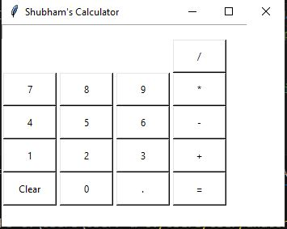
Project Overview :-
Making of an Manual Calculator and it’s presentation with the help of Graphical User Interface is very effective way to showcase the window of working calculator.

Slide 3
Project Highlights :- This GUI based calculator can do simple mathematical functions
Manual Calculator using GUI.
This Calculator is made for simple mathematical calculation.
It contains simple functions like :-
Additions
Subtractions
Multiplication
Divide

Slide 4
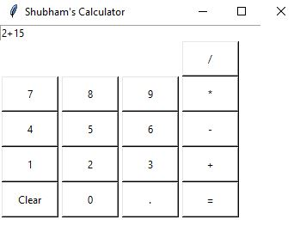
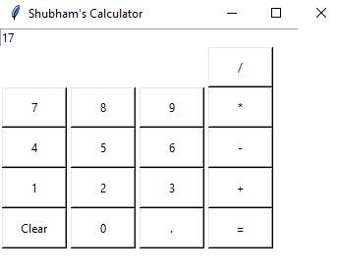
Problem Statement:- here we are doing some functions of calculator

Slide 5
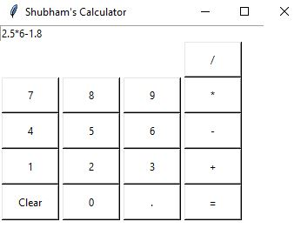
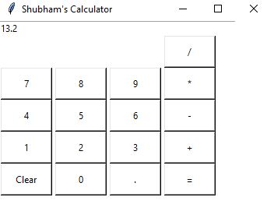
Solutions:- Checking the working of Calculator

Slide 6
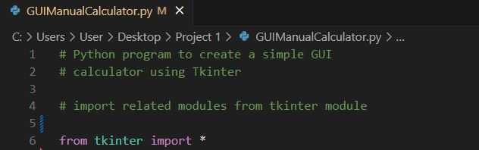
Methodology:- Used related modules from tkinter module
Some Commands like:-
button1 = Button(gui, text=' 1 ', fg='black', bg='white',
command=lambda: press(1), height=2, width=8)
button1.grid(row=6, column=0)
plus = Button(gui, text=' + ', fg='black', bg='white',
command=lambda: press("+"), height=2, width=8)
plus.grid(row=6, column=3)
divide = Button(gui, text=' / ', fg='black', bg='white',
command=lambda: press("/"), height=2, width=8)
divide.grid(row=3, column=3)

Slide 7
Methodology:- Used related modules from tkinter module
Some Commands like:-
clear = Button(gui, text='Clear', fg='black', bg='white',
command=clear, height=2, width=8)
clear.grid(row=7, column='0')
Decimal= Button(gui, text='.', fg='black', bg='white',
command=lambda: press('.'), height=2, width=8)
Decimal.grid(row=7, column=2)
gui.mainloop()
# for loop purpose.

Slide 8
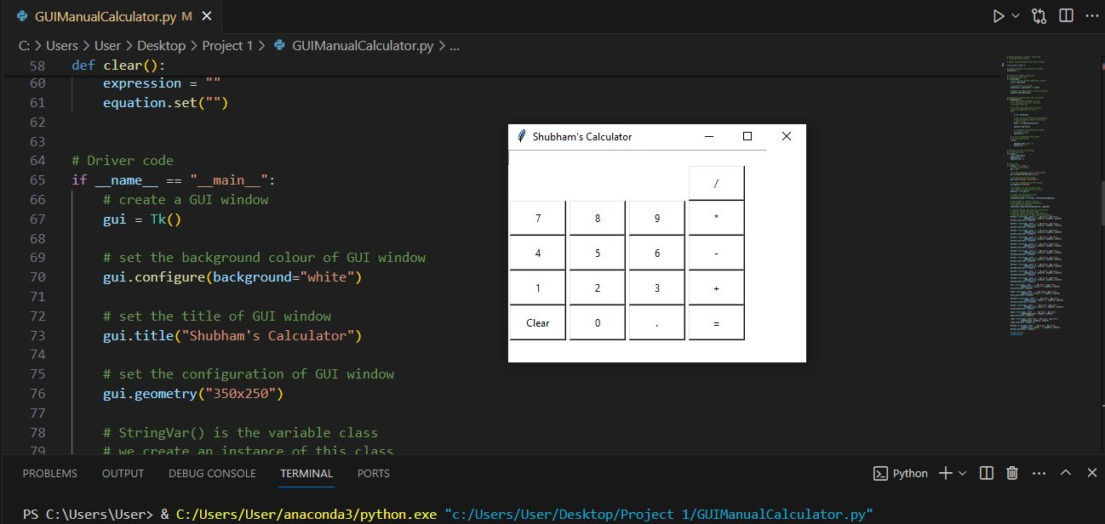
Glimpse of Programing of Calculator

Slide 9


